Slide 1
CS106: Digital Logic
Chapter 2
Boolean Algebra and Logic Gates
Notes:
١٤٤٨/٠٥/٢٩

Slide 2
Contents
Introduction and Why study Boolean Algebra?
Basic Definitions
Definition of Boolean Algebra
Postulates and Theorems of Boolean Algebra
Prepared by Dr. Sultan S. Alqahtani
Notes:
١٤٤٨/٠٥/٢٩

Slide 3
Introduction to Boolean Algebra
Boolean algebra deals with logic variables, which may either be 1, that is TRUE or 0, that is FALSE.
It uses logic variables and logic operations to develop, manipulate, and simplify logic expressions, following set rules.
Boolean algebra, introduced by George Boole in 1854, differs significantly from conventional algebra.
The rules of Boolean algebra are simple and straightforward, and can be applied to any logical expression.
Prepared by Dr. Sultan S. Alqahtani
Notes:
١٤٤٨/٠٥/٢٩

Slide 4
Why study Boolean Algebra?
It is highly desirable to find the simplest circuit implementation with the smallest number of gates or wires.
We can use Boolean minimization process to reduce a Boolean function (expression) to its simplest form: The result is an expression with the fewest literals (variables) and thus less wires in the final gate implementation.
Prepared by Dr. Sultan S. Alqahtani
Notes:
١٤٤٨/٠٥/٢٩

Slide 5
Key Words
TRUE: In Boolean algebra true means “1”.
FALSE: In Boolean algebra false means “0”.
Boolean algebra: Boolean algebra is the algebra of propositions. It deals with two values, 0 and 1 or true and false
Boolean or logic variable: It is a variable that can be assigned any one of the two values, 0 or 1.
Axiom: It is an established statement or proposition.
Prepared by Dr. Sultan S. Alqahtani
Notes:
١٤٤٨/٠٥/٢٩

Slide 6
Basic Definitions
The most common postulates used to formulate various algebraic structures are:
Closure: A set of S is closed with respect to a binary operator if, for every pairs of elements of S, the binary operator specifies a rule for obtaining a unique element of S.
Associative laws: A binary operation on a set S is said to be associative whenever (x*y)*z = x * (y*z) for all x,y,z Є S.
Commutative laws: A binary operation * on a set S is said to be commutative whenever x*y = y*x, for all x, y Є S.
Prepared by Dr. Sultan S. Alqahtani
Notes:
١٤٤٨/٠٥/٢٩

Slide 7
Basic Definitions
Identity laws: A set B is said to have an identity element with respect to a binary operation {*} on S if there exists an element designated by e in S with the property: e*x = x*e = x, for all x Є S.
Inverse / Complement: A set S having the identity element with respect to the binary operation * is said to have an inverse wherever, for each x Є S, there exists an element y Є S such that x*y = e.
Distributive laws: If “*” and “.” are two binary operators on a set S, “*” is said to be distributive over “.” whenever x* (y . z) = (x*y) . (x * z)
Prepared by Dr. Sultan S. Alqahtani
Notes:
١٤٤٨/٠٥/٢٩

Slide 8
Definition of Boolean Algebra
Boolean algebra is an algebraic structure define by set of elements, B, together with two binary operators, “+” and “.”, provided the following (Huntington) postulates are satisfied:
1. (a) Closure with respect to the operator “+”.
(b) Closure with respect to the operator “.”.
2. (a) An identity element with respect to +, designated by 0: x+0 = 0+x = x.
(b) An identity element with respect to “.”, designated by 1: x.1 = 1.x = x.
Prepared by Dr. Sultan S. Alqahtani
Notes:
١٤٤٨/٠٥/٢٩

Slide 9
Definition of Boolean Algebra
3. (a) Commutative with respect to “+”: x+y = y+x.
(b) Commutative with respect to “.”: x.y = y.x.
4. (a) . is distributive over “+”: x.(y+z) = (x.y) + (x.z)
(b) + is distributive over “.”: x+(y.z) = (x+y) . (x+z)
5. For every element xЄB, there exists an element x’ЄB (complement of x) such that (a) x+x’ = 1 (b) x.x’ = 0.
6. There exists at least two elements x,yЄ B such that x≠y.
Note: Part(b) may be obtained from part(a) and vise-versa, if operators and identity elements are interchanged. This property is called duality principle.
Prepared by Dr. Sultan S. Alqahtani
Notes:
١٤٤٨/٠٥/٢٩

Slide 10
Two valued Boolean Algebra
A two valued Boolean algebra is defined on a set of two elements, B ={0,1}, with the laws of “+” (OR), “.” (AND) and _’ (NOT) as shown below.
We show that the Huntington are valid for the set B={0,1} and the two binary operators “+” and “.”.
x y | x.y
0 0 0 1 1 0 1 1 | 0 0 0 1
x y | x+y
0 0 0 1 1 0 1 1 | 0 1 1 1
x | x’
0 1 | 1 0
Prepared by Dr. Sultan S. Alqahtani
Notes:
١٤٤٨/٠٥/٢٩

Slide 11
Two valued Boolean Algebra
x y | x.y
0 0 0 1 1 0 1 1 | 0 0 0 1
x y | x+y
0 0 0 1 1 0 1 1 | 0 1 1 1
x | x’
0 1 | 1 0
Closure is obvious from the tables since the result of each operation is either 0 or 1 and 0, 1 Є B
From the table we see
(a) 0 + 0 = 0 0 + 1 = 1 + 0 = 1
(b) 1 . 1 = 1 0 . 1 = 1 . 0 = 0
This establishes two identities- 0 for OR and 1 for AND .
The commutative laws are obvious from the symmetry of the tables.
The distributive laws can be shown true by using truth table.
From the complement table it is easily shown that
(a) x + x’ = 1, as 0+0’ = 0+1 = 1 & 1+1’ = 1+0 = 1
(b) x . x’ = 0, as 0.0’ = 0.1 = 0 & 1 . 1’ = 1 . 0 = 0
6. 0, 1 ЄB and 0 ≠ 1.
Prepared by Dr. Sultan S. Alqahtani
Notes:
١٤٤٨/٠٥/٢٩

Slide 12
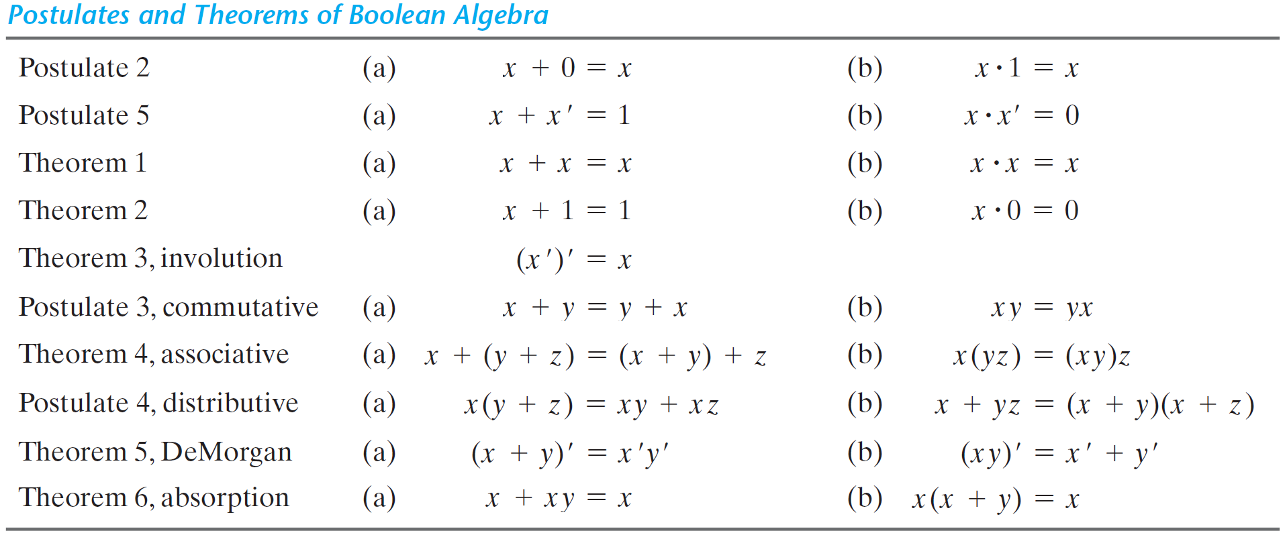
Basic Theorems and Properties of Boolean Algebra
From the previous axioms, we can derive the following theorems:
Prepared by Dr. Sultan S. Alqahtani

Slide 13
Postulates and Theorems
Theorem 1(a): x + x = x
Prove: x + x = (x+x).1 by postulate: 2(b)
= (x+x).(x+x’) 5(a)
= x + xx’ 4 (b)
= x + 0 5(b)
= x 2(a)
Theorem 1(b): x . x = x
Prove: x . x = xx + 0 2 (a)
= xx + xx’ 5(b)
= x (x + x’) 4(a)
= x . 1 5(a)
=x 2(b)
Note: each step of the proof in (b) is the dual of (a)
Prepared by Dr. Sultan S. Alqahtani
Notes:
١٤٤٨/٠٥/٢٩

Slide 14
Postulates and Theorems
Theorem 2 (a): x +1 = 1
  Prove: x + 1 = 1. (x + 1) from P 2(b)
= (x + x’) (x + 1) 5(a)
= x + x’ .1 4(b)
= x + x’ 2(b)
= 1 5(a)
Theorem 6 (a): x + xy = x
  Prove: x + xy = x . 1 + xy
= x . ( 1 + y)
= x . 1
= x
Note: The theorems can be proofed by true table (HW)
Prepared by Dr. Sultan S. Alqahtani
Notes:
١٤٤٨/٠٥/٢٩

Slide 15
Postulates and Theorems
Theorem 5 (a): DeMorgan – by truth table
  Prove – with algebraically is too long
(x + y)’ = x’y’
x | y | x+y | (x+y)’
0 | 0 | 0 | 1
0 | 1 | 1 | 0
1 | 0 | 1 | 0
1 | 1 | 1 | 0
x' | y’ | x’y’
1 | 1 | 1
1 | 0 | 0
0 | 1 | 0
0 | 0 | 0
LHS
RHS
Prepared by Dr. Sultan S. Alqahtani
Notes:
١٤٤٨/٠٥/٢٩

Slide 16
Postulates and Theorems
Theorem 2 (b): x . 0 = 0 (HW)
Theorem 3: (x’)’ = x (HW)
Theorem 6 (a): x + x y = x (HW)
Theorem 6(b): x (x + y) = x (HW)
Note: The theorems can be proofed by true table (HW)
Prepared by Dr. Sultan S. Alqahtani
Notes:
١٤٤٨/٠٥/٢٩

Slide 17
Generalization
Theorems 4 and 5 can be generalize to more than 2 variables
  Example:
    (A1 + A2 + … + An)’ = A1’ . A2’ . … . An’
    (A1 . A2 . … . An)’ = A1’ + A2’ + … + An’
Operator Precedence
  () -> NOT -> AND -> OR
  Example: x + y . (x + z)’
Prepared by Dr. Sultan S. Alqahtani
Notes:
١٤٤٨/٠٥/٢٩

Slide 18
Boolean Functions
Prepared by Dr. Sultan S. Alqahtani

Slide 19
Binary Logic and Logic Gates
A binary (Boolean) variable assumes only one of 2 permissible values (1/0, T/F).
Binary number ⇒ 2 symbols (0, 1); binary signal ⇒ 2 states (Low, High).
Three basic operations: AND, OR, NOT.
The logic circuit elements that perform these operations are called logic gates.
Why do we call them gates? It stops/allows the flow of logic (i.e., logic ‘1’ or logic ‘0’)
Prepared by Dr. Sultan S. Alqahtani
Notes:
١٤٤٨/٠٥/٢٩

Slide 20
Logic Gates
Digital computers
  Imply that the computer deals with digital information, i.e., it deals with the information that is represented by binary digits
  Why binary? Instead of Decimal or other number system?
  Consider electric signal
  Consider the calculation cost - Add
1
7
6
5
4
3
2
1
0
signal
range
0
binary octal
0 1 2 3 4 5 6 7 8 9
0 0 1 2 3 4 5 6 7 8 9
1 1 2 3 4 5 6 7 8 9 10
2 2 3 4 5 6 7 8 9 1011
3 3 4 5 6 7 8 9 101112
4 4 5 6 7 8 9 10111213
5 5 6 7 8 9 1011121314
6 6 7 8 9 101112131415
7 7 8 9 10111213141516
8 8 9 1011121314151617
9 9 101112131415161718
0 1
0 1
1 10
0
1
Prepared by Dr. Sultan S. Alqahtani

Slide 21
Basic Logic Block – GATE -
Binary
Digital
Input
Signal
Binary
Digital
Output
Signal
.
.
.
Gate
Types of basic logic blocks
  Combinational Logic Block: logic blocks whose output logic value depends only on the input logic values
  Sequential Logic block: logic blocks whose output logic value depends on the input values and the sate (stored information) of the blocks
Functions of Gates can be described by
  Truth table
  Boolean Function
  Karnaugh Map
Prepared by Dr. Sultan S. Alqahtani

Slide 22
Name Symbol Function Truth Table
A X = A • B
X or
B X = AB
A B X
AND
0 0 0
0 1 0
1 0 0
1 1 1
0 0 0
0 1 1
1 0 1
1 1 1
A
X X = A + B
B
A B X
OR
NOT
A X
A X X = A’
0 1
1 0
Buffer A X X = A
A X
0 0
1 1
A B X
NAND
A
X X = (AB)’
B
0 0 1
0 1 1
1 0 1
1 1 0
A
X X = (A + B)’
B
A B X
NOR
0 0 1
0 1 0
1 0 0
1 1 0
XOR
Exclusive OR
A X = A ⊕ B
X or
B X = A’B + AB’
A B X
0 0 0
0 1 1
1 0 1
1 1 0
XNOR
A X = (A ⊕ B)’
X or
B X = A’B’+ AB
A B X
0 0 1
0 1 0
1 0 0
1 1 1
Exclusive NOR
or Equivalence
Prepared by Dr. Sultan S. Alqahtani

Slide 23
Boolean Function
Boolean Algebra is an algebra that deals with binary valuables and logical operations.
Boolean Function described by an algebraic expression consists of binary variables, the constant 0, 1 and logic operation symbols.
The output of any function can be equal to 0 or 1.
Example: F = x + y' z;
Question: When F=1 and F=0?
It can be presented by Truth Table, where number of rows is equal to 2^{n} where n is number of valuables.
The combinations are binary numbers from 0 to 2^{n}-1.
Prepared by Dr. Sultan S. Alqahtani
Notes:
١٤٤٨/٠٥/٢٩

Slide 24
Boolean Function
The truth table for the functions
F₁ = x + y’z and F₂ = x’y’z + x’yz + xy’ is as follows:
x y z | F₁ F₂
0 0 0 0 0 1 0 1 0 0 1 1 1 0 0 1 0 1 1 1 0 1 1 1 | 0 0 1 1 0 0 0 1 1 1 1 1 1 0 1 0
Prepared by Dr. Sultan S. Alqahtani
Notes:
١٤٤٨/٠٥/٢٩

Slide 25
Logic Circuit Design
x y z F
0 0 0 0
0 0 1 1
0 1 0 0
0 1 1 0
1 0 0 1
1 0 1 1
1 1 0 1
1 1 1 1
Truth
Table
Boolean
Function
F = x + y’z
x
F
Logic
Diagram
y
z
Prepared by Dr. Sultan S. Alqahtani

Slide 26
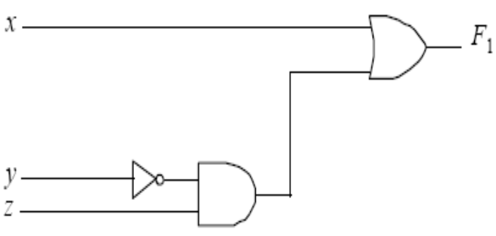
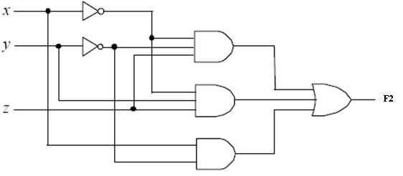
Boolean Function
Note: F₁ has two terms with three literals, and F₂ has three terms with eight literals.
Literal is a single variable within a term that may be complemented or not.
The functions can be transformed from algebraic expressions to circuit diagrams of logic gates as follows.
Prepared by Dr. Sultan S. Alqahtani
Notes:
١٤٤٨/٠٥/٢٩

Slide 27
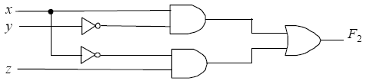
Boolean Function
Consider simplification of F₂ ;
F₂ = x’ y’ z + x’ y z + x y’ = x’ z (y’+y) + x y’ = x’ z + x y’
The function is reduced to only two terms and can be implemented with fewer gates as follows.
It is preferable because it requires less wires and components.
Prepared by Dr. Sultan S. Alqahtani
Notes:
١٤٤٨/٠٥/٢٩

Slide 28
Boolean Function
Simplify the following Boolean function to a minimum number of terms:
  F₁ = x ( x’ + xy)
  F₂ = xy + x’y + yz
  F₃ = (x(y’z’ + yz))’
Prepared by Dr. Sultan S. Alqahtani
Notes:
١٤٤٨/٠٥/٢٩

Slide 29
Canonical forms
Canonical Forms is useful to specify Boolean functions in a form that:
  Allows comparison for equality.
  Has a correspondence to the truth tables
Canonical Forms in common usage:
  Sum of Minterms (SoM)
  Product of Maxterms (PoM)
Minterms are AND terms, and Maxterms are OR terms with every variable present in either normal (e.g., x) or complemented (e.g., x’) form.
There are 2^{n} Minterms/Maxterms for n variables.
Two variables (x and y) produce 4 minterms: x’y’, x’y, xy’ and xy; and 4 maxterms: x+y, x+y’, x’+y, x’+y’.
Prepared by Dr. Sultan S. Alqahtani
Notes:
١٤٤٨/٠٥/٢٩

Slide 30
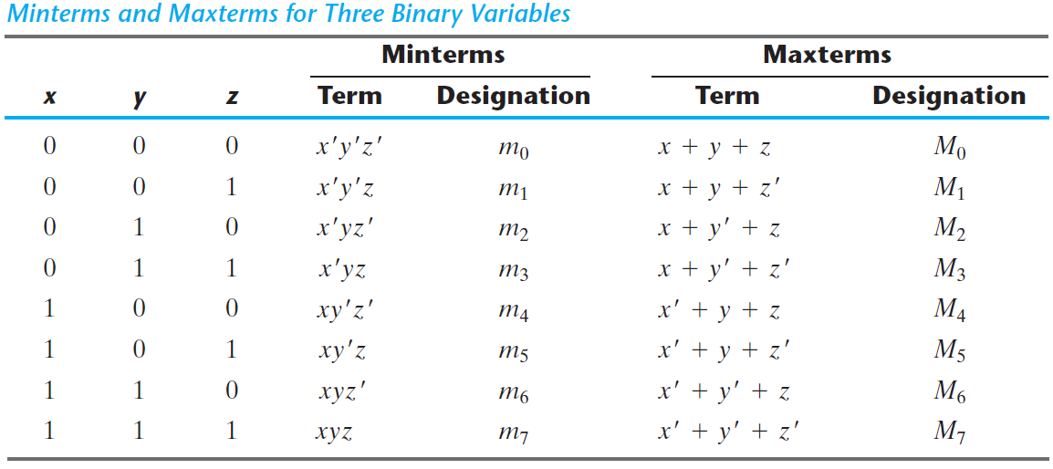
Canonical forms
Minterm and maxterm are also called standard product and standard sum respectively.
Prepared by Dr. Sultan S. Alqahtani
Notes:
١٤٤٨/٠٥/٢٩

Slide 31
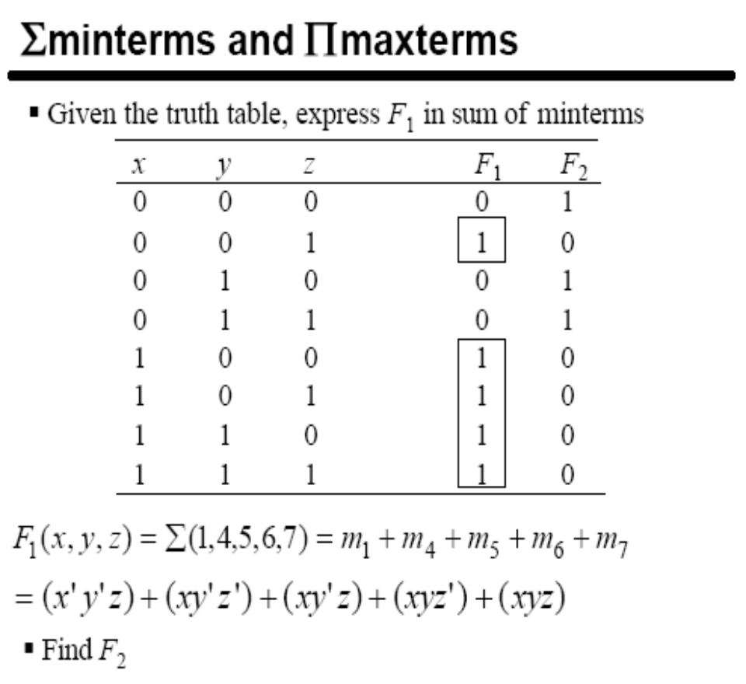
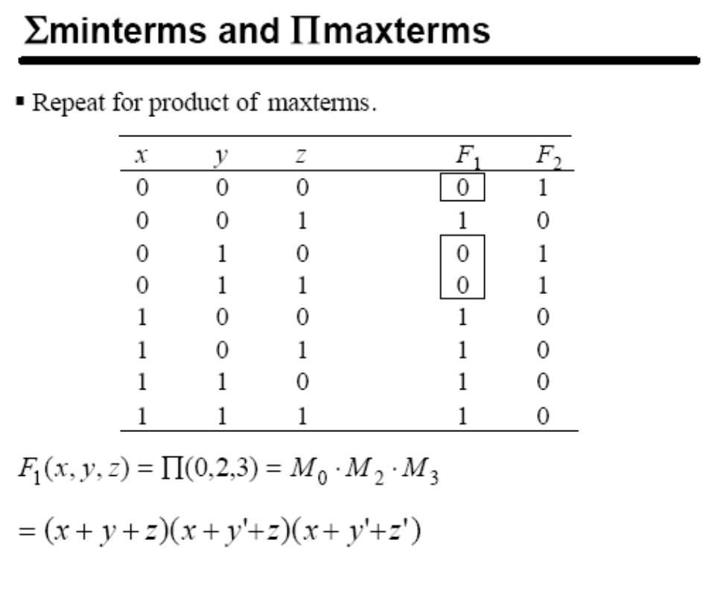
Canonical forms
Prepared by Dr. Sultan S. Alqahtani
Notes:
١٤٤٨/٠٥/٢٩

Slide 32
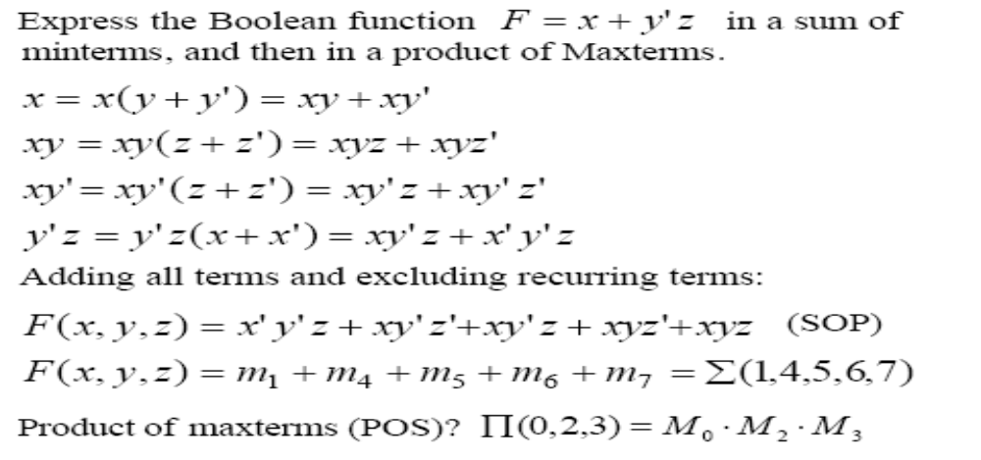
Canonical forms
Any Boolean function can be expressed as sum of minterms or product of maxterms are said to be in canonical form.
Prepared by Dr. Sultan S. Alqahtani
Notes:
١٤٤٨/٠٥/٢٩

Slide 33
Conversion between forms
To convert from sum-of-minterms to product-of-maxterms form (or vice-versa) we follow these steps:
  Find the function complement by swapping terms in the list with terms not in the list.
  Change from products to sums, or vice versa.
Example: Given F₁ as before: F₁ = Σ(1, 4, 5, 6, 7)
Form the Complement: F₁’ = Σ(0, 2, 3)
Then use the other form with the same indices – this
forms the complement again, giving the other form of the original function: F₁ = Π(0, 2, 3)
Prepared by Dr. Sultan S. Alqahtani
Notes:
١٤٤٨/٠٥/٢٩

Slide 34
Standard forms
There are two types of standard forms: sum of products and product of sums
The sum of products (SoP) is a Boolean expression containing AND terms, called product terms, of one or more literals each; e.g., F₁ = y’ + xy + x’yz’
The Product of sum (PoS) is a Boolean expression containing OR terms, called sum terms, of one or more literals each; e.g., F₂ = x(y’ + z)(x’ + y + z’)
A Boolean function may be expressed as nonstandard form, e.g., F₃ = AB + C(D + E)
It can be changed to a standard form by using distributive law; e.g., F₃ = AB + CD + CE.
Prepared by Dr. Sultan S. Alqahtani
Notes:
١٤٤٨/٠٥/٢٩

Slide 35
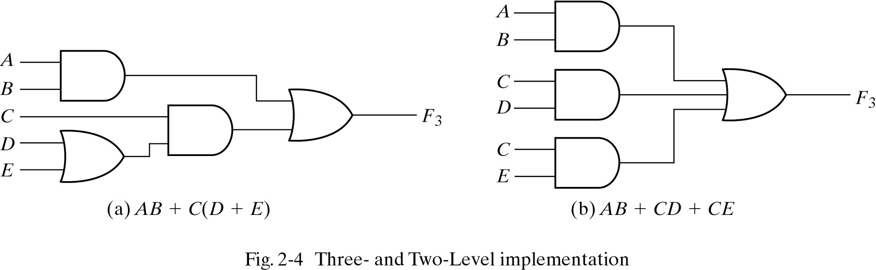
Standard forms
The implementation of nonstandard F₃ requires two AND gates and two OR gates using three levels of gating; whereas standard F₃ can be implemented using two levels of gating, which is preferred because it produces least amount of delay through the gates when the signal propagates from input to output.
Prepared by Dr. Sultan S. Alqahtani
Notes:
١٤٤٨/٠٥/٢٩

Slide 36
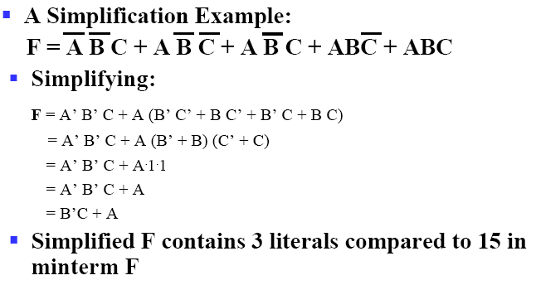
Standard forms
  Boolean algebra can be used to manipulate equations into simpler forms.
  Simpler equations lead to simpler two-level implementations.
Prepared by Dr. Sultan S. Alqahtani
Notes:
١٤٤٨/٠٥/٢٩

Slide 37
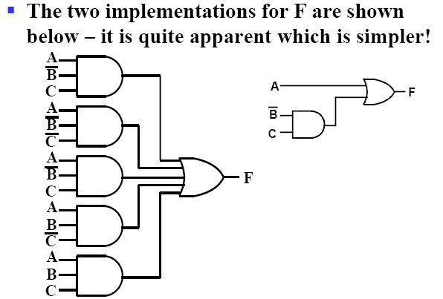
Standard forms
Prepared by Dr. Sultan S. Alqahtani
Notes:
١٤٤٨/٠٥/٢٩

Slide 38
Conclusion
Algebraic function -> how to represent in truth table
Truth table -> how to implement algebraic function
Simplify the function implementation
Prepared by Dr. Sultan S. Alqahtani

Slide 39
End of Chapter II
Prepared by Dr. Sultan S. Alqahtani
Notes:
١٤٤٨/٠٥/٢٩

